Slide 1
INFOSYS SPRINGBOARD PROJECT
ElectViz
Election Data Visualization for Media
India General Election Results — 2024
Power BI Dashboard Analytics & Insights
Team C | Infosys Springboard
Presented by: HarshaVardhan Vinukonda
Mythri Malraju
Poonam Sharma
Snehal Gurnule
Samyak Labhane
Mentor:- Ajay V

Slide 2
Table of Contents
Structure of the Presentation
01
Abstract
08
Dashboard 2 - State Analysis Dashboard
02
Background & Motivation
09
Dashboard 3 - Constituency Analysis Dashboard
03
Project Overview
10
Dashboard 4 - Party Strategy & Performance Dashboard
04
Dataset Overview
11
Key Findings & Insights
05
Data Modeling & Architecture
12
Challenges & Solutions
06
DAX Measures & Business Logic
13
Conclusion
07
Dashboard 1 – Overview Analysis
Infosys ElectViz | Team C | India General Election 2024

Slide 3
Abstract
Project Summary
ElectViz is an interactive Power BI dashboard solution developed as part of the Infosys Springboard Capstone Project by Team C. The project focuses on transforming raw India General Election 2024 data into actionable, media-ready visual insights. The solution encompasses three analytical dimensions: State-level demographics, Constituency-level results, and Party-wise strategy performance. Together, these dashboards enable journalists, political analysts, and the general public to explore election outcomes interactively. Key deliverables include dynamic slicers, DAX-powered KPIs, alliance-based seat segmentation, and visual storytelling through charts, maps, and scorecards.
Power BI
4
4
543
Platform
Dashboards
CSV Datasets
Constituencies
Infosys ElectViz | Team C | India General Election 2024

Slide 4
Background & Motivation
Why ElectViz?
📊
Data Complexity
India's 2024 general election involved 543 constituencies, hundreds of parties, and millions of votes — making manual analysis impossible at scale.
📰
Media Demand
News organizations and media houses needed real-time, interactive dashboards for accurate election reporting and audience engagement.
🔍
Transparency Gap
Voters and political analysts lacked a single, unified view of election performance across alliances, states, and constituencies.
💡
Infosys Springboard Goal
To apply data engineering and visualization skills in a real-world, high-impact scenario using Power BI and DAX.
Infosys ElectViz | Team C | India General Election 2024

Slide 5
Project Overview
ElectViz — Architecture at a Glance
State Analysis
Constituency Analysis
Party Strategy
Overview Analysis
This dashboard shows a state-wise overview of the 2024Indian elections (Bihar),including seat distribution,total votes, and partyperformance.
Constituency-level winner, runner-up, vote share, margin details, and participating candidates.State-wise seat distribution, NDAvs INDIA alliance breakdown,geographic mapping with hoverdetails
Party-wise performance scorecard, vote share %, strike rate, and best-performing party per constituency. Constituency-level winner,runner-up, vote share, margindetails, and participatingcandidates
Party-wise performance scorecard, vote share %, strike rate, and best-performing party per constituency.
Project Workflow
Raw CSV Data
→
Power Query ETL
→
Data Modeling
→
DAX Measures
→
Dashboard Design
→
Insights & Reporting
Infosys ElectViz | Team C | India General Election 2024

Slide 6
Dataset Overview
Source Data Used in the Project
1. CandidateResults.csv
Contains individual candidate-level results for all 543 constituencies. | Key Columns: Constituency ID, Candidate Name, Party, Total Votes, EVM Votes, Postal Votes, Vote Share %
2. ConstituencyWiseResults.csv
Captures the final outcome of each constituency — winner, runner-up, and second runner-up. | Key Columns: Constituency ID, Constituency Name, State, Winning Candidate, Winning Party, Winning Margin
3. PartyWiseResults.csv
Provides party-level performance aggregated across constituencies. | Key Columns: Party Name, Seats Won, Alliance (derived using DAX logic)
4. StateDemographics.csv
Supports state-level geographic and demographic analysis. | Key Columns: State Name, Total Seats, NDA Seats, INDIA Seats, Other Seats
Infosys ElectViz | Team C | India General Election 2024

Slide 7
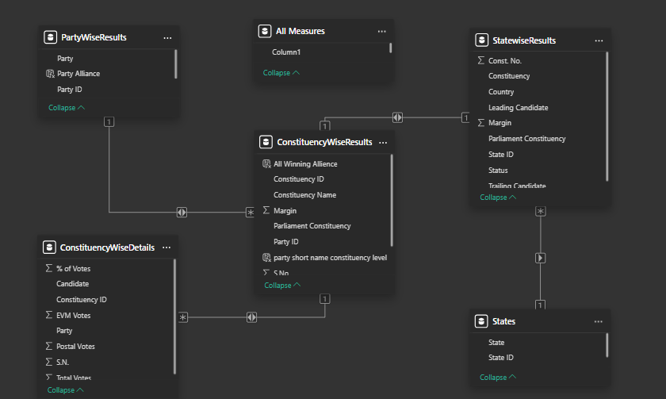
Data Modeling & Architecture
Model View in Power BI
Dim: Constituencies
Dim: Parties
Fact: CandidateResults
Dim: States
Infosys ElectViz | Team C | India General Election 2024

Slide 8
DAX Measures & Business Logic
Core Calculations Powering the Dashboards
Total Seats Won
CALCULATE(COUNTROWS(PartyWiseResults), [Seats] > 0)
Aggregates total constituencies won per party or alliance.
Vote Share %
DIVIDE([Total Votes Party], [Total Votes All], 0) * 100
Computes percentage of total votes secured by each party.
Alliance Classification
SWITCH(TRUE(), Party IN NDA_LIST, "NDA", Party IN INDIA_LIST, "I.N.D.I.A.", "Others")
Classifies each party into the correct political alliance.
Strike Rate %
DIVIDE([Seats Won], [Total Candidates Fielded], 0) * 100
Measures efficiency of seats converted from candidates fielded.
Winning Margin
MAX(Candidate Votes) - SECOND MAX(Candidate Votes)
Calculates absolute vote margin of the winning candidate.
Infosys ElectViz | Team C | India General Election 2024

Slide 9
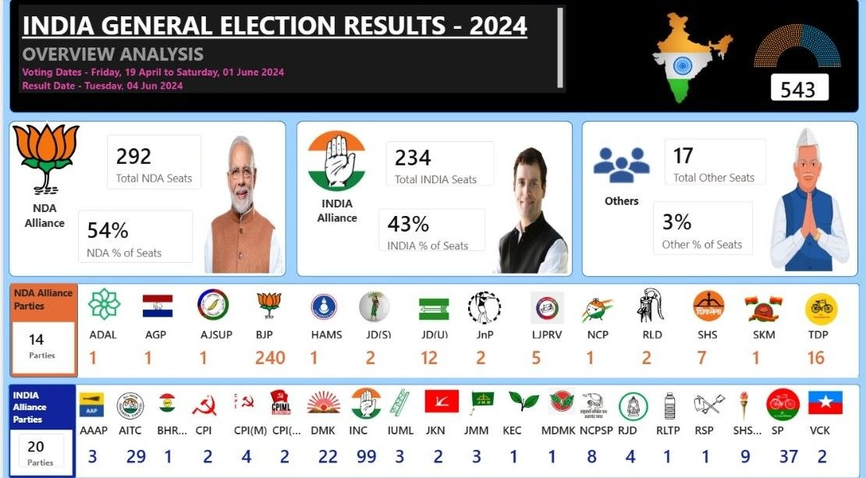
Dashboard 1 — Overview Analysis
National-Level Election Results Summary
Infosys ElectViz | Team C | India General Election 2024

Slide 10
Overview Analysis — Key Insights
What the National Dashboard Reveals
NDA Alliance:
Won 292 seats (54%), giving it a comfortable majority in the 543-seat Lok Sabha with BJP leading at 240 seats.
I.N.D.I.A. Alliance:
Secured 234 seats (43%), a significant improvement over expectations, led by INC with 99 seats.
Others & Independents:
17 seats (3%) went to parties outside both major alliances, indicating fragmented regional presence.
Total Votes Cast:
Over 43.4 crore total votes recorded across all constituencies, with 43.3 crore via EVM and 1.39 lakh postal votes.
Alliance Composition:
NDA comprised 14 parties; I.N.D.I.A. alliance had 20 parties — reflecting the coalition nature of modern Indian politics.
Infosys ElectViz | Team C | India General Election 2024

Slide 11
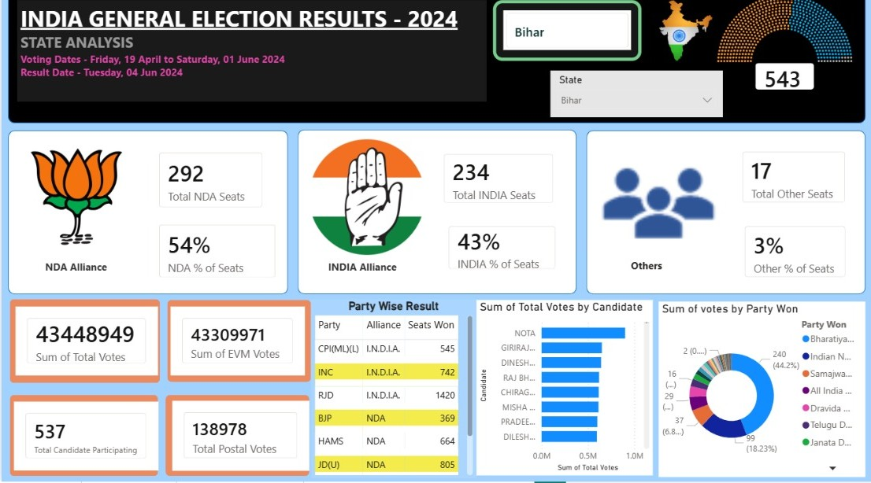
Dashboard 2 — State Analysis
State-Wise Seat Distribution & Alliance Performance
Infosys ElectViz | Team C | India General Election 2024

Slide 12
State Analysis — Overview & Features
How the State Dashboard Works
The State Analysis Dashboard provides a comprehensive state-wise breakdown of election results with interactive drill-down capabilities.
State Selector
Alliance KPIs
A dropdown slicer allows users to filter all visuals for any specific state, enabling focused state-level analysis.
Displays NDA, I.N.D.I.A., and Others seat counts and seat percentages prominently as card visuals for the selected state.
Party-Wise Result Table
Vote Distribution Charts
Tabular breakdown of each party's alliance and total seats won, filterable by state selection.
Bar chart showing total votes by top candidates; donut chart illustrating seat share by party won.
Bihar Example Shown
EVM vs Postal Votes
For Bihar: NDA won 292 total seats nationally; JD(U) contributed 805 seats, BJP 369, and HAMS 664 at candidate level.
Dashboard compares total EVM votes (43.3 Cr) against postal votes (1.38 lakh) for transparency.
Infosys ElectViz | Team C | India General Election 2024

Slide 13
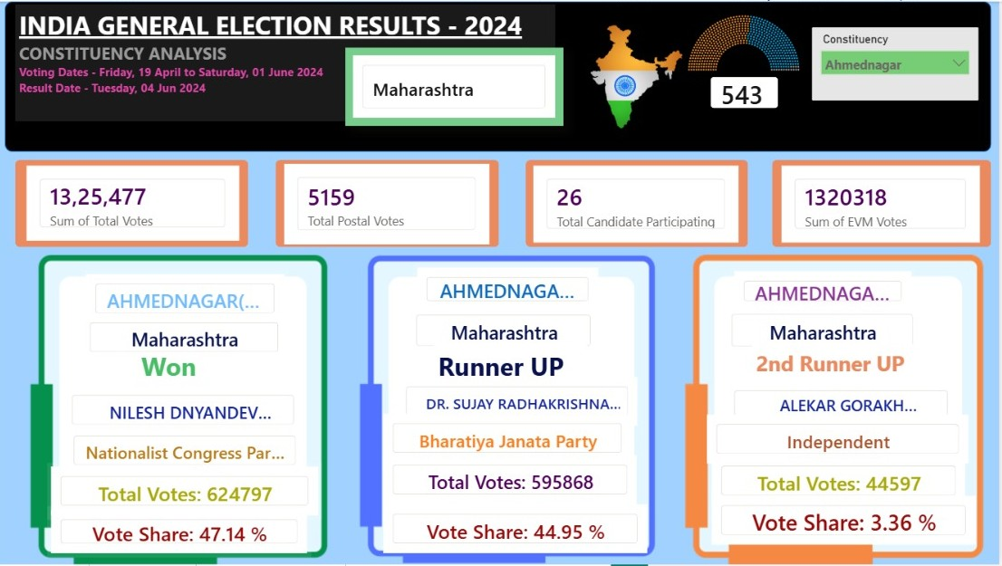
Dashboard 3 — Constituency Analysis
Ahmednagar, Maharashtra — Detailed Result Breakdown
Infosys ElectViz | Team C | India General Election 2024

Slide 14
Constituency Analysis — Overview & Features
Drill Down to Individual Constituencies
Ahmednagar, Maharashtra — Case Study (1,325,477 Total Votes | 26 Candidates)
WINNER
RUNNER-UP
2ND RUNNER-UP
Nilesh Dnyandev Lanke
Dr. Sujay Radhakrishna
Alekar Gorakh
Nationalist Congress Party
Bharatiya Janata Party
Independent
6,24,797 votes | 47.14%
5,95,868 votes | 44.95%
44,597 votes | 3.36%
Constituency Analysis — Key Insights
Nilesh Dnyandev Lanke (NCP) won Ahmednagar with a clear lead of ~2.19% vote share over BJP, indicating a tight but decisive contest.
The competition between NCP (47.14%) and BJP (44.95%) shows a two-party dominance, with very little space for other parties.
The vote difference (~28,929 votes) between winner and runner-up highlights a moderately competitive constituency, not a landslide.
The 2nd runner-up (Independent) secured only 3.36% vote share, proving that independent candidates have minimal influence in this constituency.
Out of 26 candidates, only the top 2 had significant vote share → high vote concentration, low fragmentation.
The close margin suggests that small shifts in voter preference could change future outcomes, making this a swing-sensitive constituency.
Infosys ElectViz | Team C | India General Election 2024

Slide 15
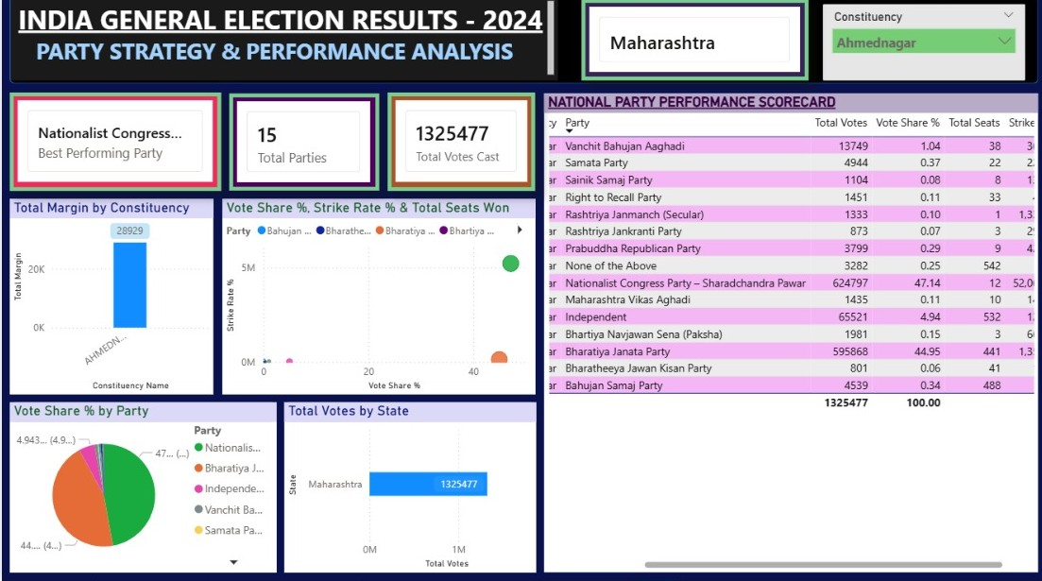
Dashboard 4 — Party Strategy & Performance
Ahmednagar, Maharashtra — Party-Wise Analysis
Infosys ElectViz | Team C | India General Election 2024

Slide 16
Party Strategy & Performance — Overview
Understanding Party-Level Electoral Patterns
Ahmednagar Example: Nationalist Congress Party (Sharad Pawar faction) performed best with 47.14% vote share and 12 total seats in Maharashtra.
Party | Total Votes | Vote Share % | Total Seats | Strike Rate
NCP – Sharad Pawar | 6,24,797 | 47.14% | 12 | 52.0
Bharatiya Janata Party | 5,95,868 | 44.95% | 441 | 1.3
Independent | 65,521 | 4.94% | 532 contested | 1.%
Vanchit Bahujan Aaghadi | 13,749 | 1.04% | 38 | 3
Bahujan Samaj Party | 4,539 | 0.34% | 488 | —
Party Strategy & Performance Analysis Key Insights:
NCP (Sharad Pawar faction) emerged as the best-performing party in Ahmednagar with 47.14% vote share and 12 seats, indicating strong local dominance.
Bharatiya Janata Party (BJP) remained a close competitor with 44.95% vote share and 5,95,868 total votes.
Independent candidates secured a small but noticeable share (4.94%), showing the presence of non-party influence.
Smaller parties like Vanchit Bahujan Aaghadi and Bahujan Samaj Party had minimal electoral impact in this region.
The vote share vs strike rate analysis highlights how some parties convert voter support into seats more efficiently than others.
Infosys ElectViz | Team C | India General Election 2024

Slide 17
Key Findings & Insights
What the Data Reveals About India 2024
NDA Majority but Weakened
INC's Strong Comeback
NDA secured 292 seats — enough for majority but fewer than the 303 won in 2019, indicating voter recalibration in key states like UP and Rajasthan.
Congress doubled its 2019 tally from ~52 to 99 seats, emerging as the single largest opposition party and anchoring the I.N.D.I.A. bloc.
Regional Parties Decisive
Low Strike Rates for Independents
States like Tamil Nadu (DMK), West Bengal (TMC), and Odisha (BJD) showed regional parties retaining dominance — national alliances had limited penetration.
Independent candidates contested massively (500+) but had very low win rates, confirming the power of party machinery over individual candidacy.
Bihar: JD(U) Dominance
Ahmednagar Margin: 28,929
In Bihar, JD(U) fielded most candidates under NDA and won significantly, reinforcing Nitish Kumar's role as a key coalition ally.
NCP's victory in Ahmednagar with a margin of 28,929 votes over BJP illustrates highly competitive constituency-level battles in Maharashtra.
Infosys ElectViz | Team C | India General Election 2024

Slide 18
Future Scope:
🔮 Predictive Analysis Implement machine learning models to predict election outcomes and voter trends.
🌐 Real-Time Data Integration Integrate live election data using APIs for real-time dashboard updates.
📊 Historical Comparison Compare results with previous elections (e.g., 2019 vs 2024) to identify trends.
📱 Web Deployment Publish the dashboard online for easy access by users and stakeholders.
Infosys ElectViz | Team C | India General Election 2024

Slide 19
Conclusion:
ElectViz successfully transforms raw India 2024 election data into a media-ready, interactive Power BI solution that serves journalists, analysts, and the public. By leveraging DAX for business logic, Power Query for data cleansing, and star schema modeling for performance, the project demonstrates end-to-end data engineering capability. The dashboards provide unprecedented access to constituency-level, state-level, and party-level insights — enabling data-driven political journalism and transparent public discourse on election outcomes.
Infosys ElectViz | Team C | India General Election 2024

Slide 20
Thank You
Infosys_ElectViz — Election Data Visualization for Media
India General Election Results 2024 | Power BI Analytics
Team C | Infosys Springboard Project
Infosys Springboard

